Slide 1
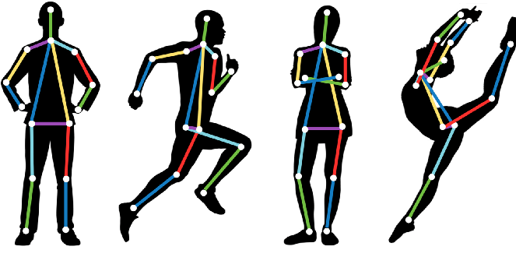
Pose Estimation using Openpose
Birudugadda Srivibhav
GitHub Repository

Slide 2
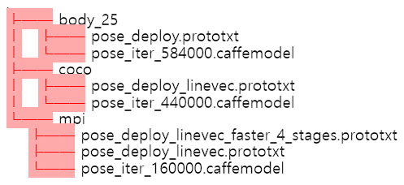
Pose Models
There are three models that extract body key points from Openpose:
We will use the BODY_25 Model : fastest for CUDA version, most accurate, and includes foot keypoints

Slide 3
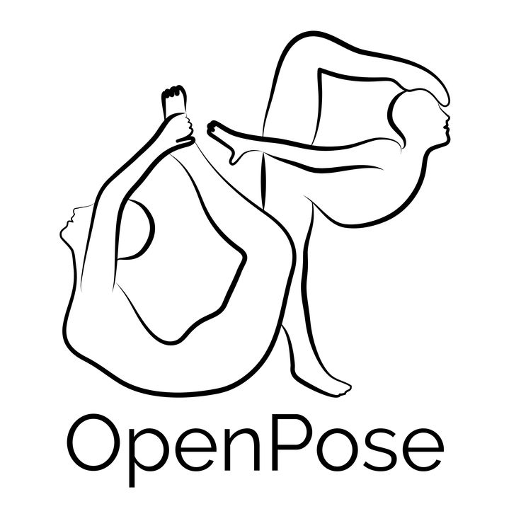

Running
Using

Slide 4
Steps involved
A simple way to use OpenCV’s dnn is as follows:
Load network model
Read Image and prepare BloB
Make predictions (forward)
Parse results (key points)
Let's create the sample python program in a way that uses OpenCV dnn.

Slide 5
Load Network Model
I am using OpenPose models trained on Caffe Framework. Caffe models have 2 files –
.prototxt file which specifies the architecture of the neural network – how the different layers are arranged etc
.caffemodel file which stores the weights of the trained model.

Slide 6
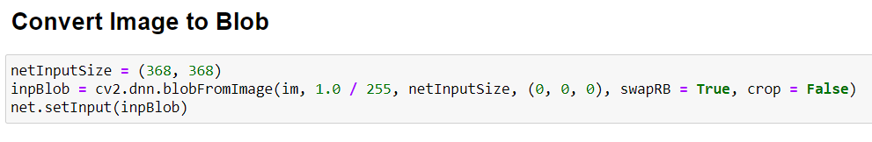
Read Image and Prepare blob
The input image that I read using OpenCV should be converted to a input blob ( like Caffe ) so that it can be fed to the network.
The blobFromImage does the job of converting the image from OpenCV format to Caffe blob format.

Slide 7
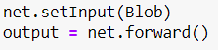
Make Prediction
Once the image is passed to the model, the predictions can be made using a single line of code.
The forward method for the DNN class in OpenCV makes a forward pass through the network and its output is the prediction results.

Slide 8
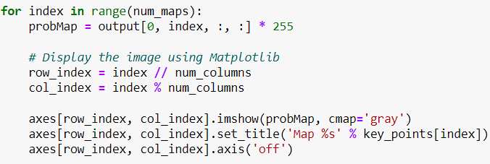
Probability maps
The probability distribution image for each part can be extracted as follows:

Slide 9
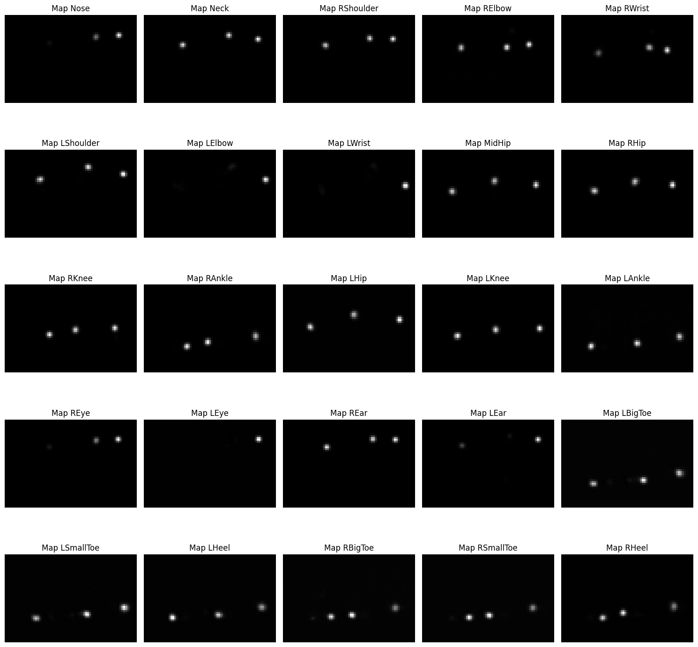
Probability maps obtained
The probability distribution image for each part can be extracted as follows:

Slide 10
Valid Keypoint Pairs Detection
Objective
Identify valid pairs, connecting body parts of the same person.
Method
Utilize the numpy dot operation.
Calculate minimum distance between one joint and all possible others.
Algorithm
Numpy dot function finds maximum value for vectors in the same direction.
If vector of joint coordinates and PAF vector align, the largest value is returned, indicating a valid keypoint joint.

Slide 11
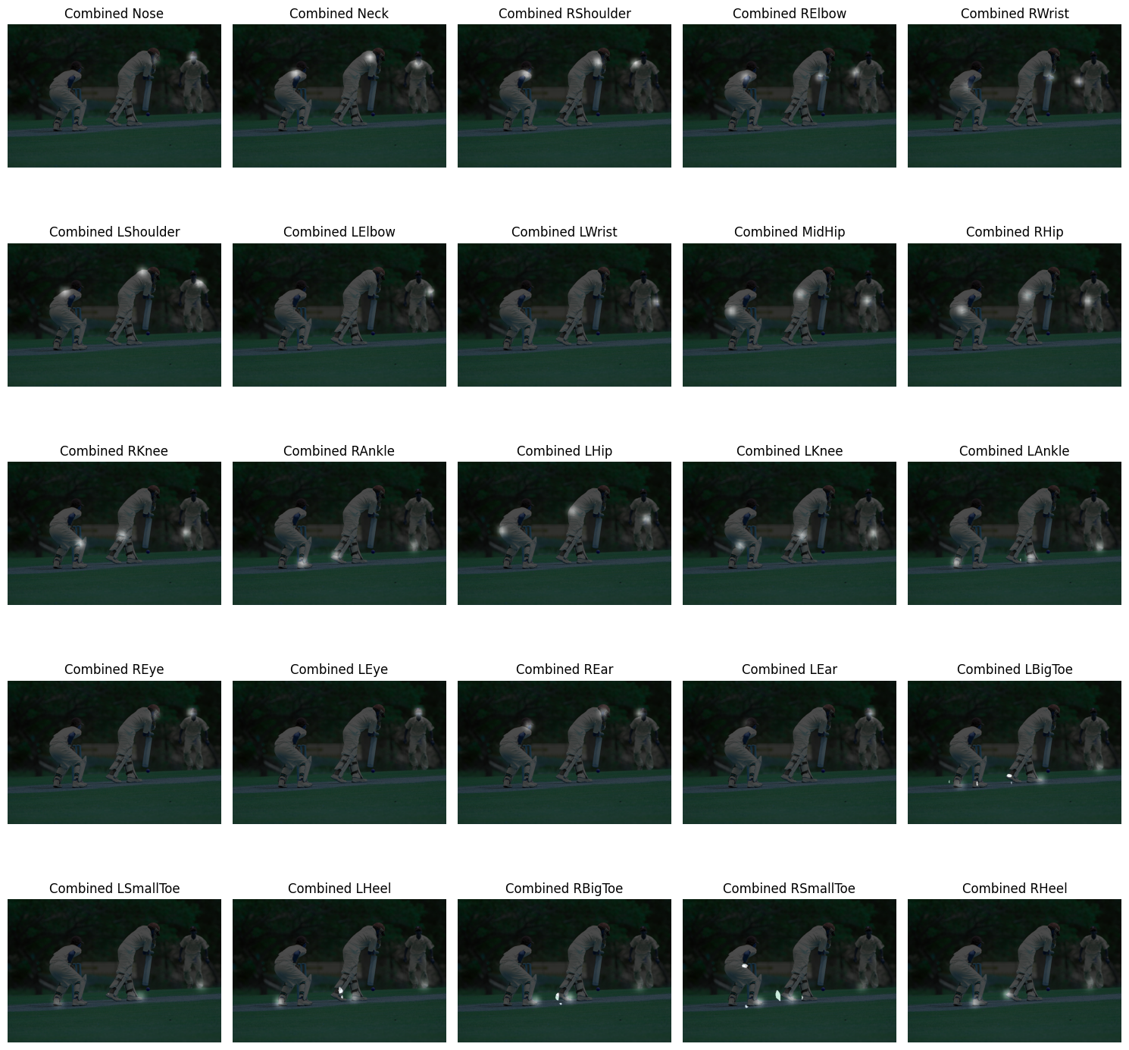
Merging P-Maps with Original Image

Slide 12
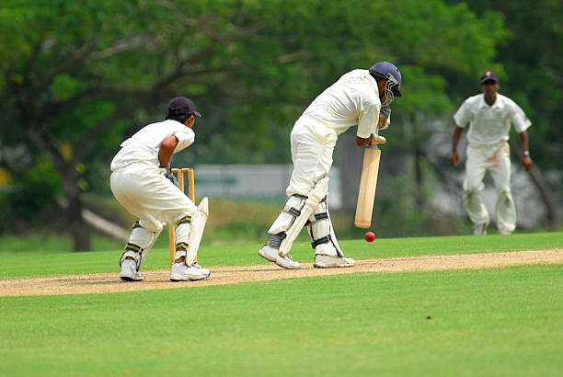
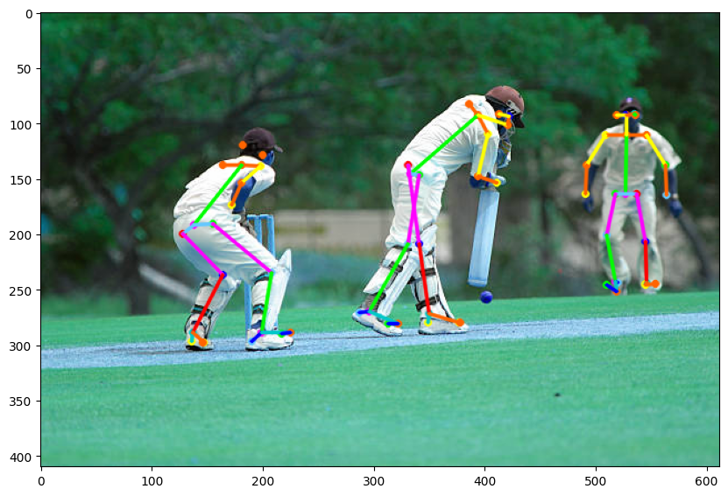
Results

Slide 13
Pose estimation in videos
A loop reads each frame from video using ‘cap.read()’, creates an ‘op.Datum’
Object, passes the current frame to the model.
After obtaining the predictions in ‘datum’, we clone the current frame and visualize the results on it by drawing and connecting the key points.
Finally the processed frame is written to the output video
This loop continues until all frames in the video are processed, and the processing time for each frame is printed during the loop. The total processing time and average frame processing rate are printed after the loop.

Slide 14
References
CMU-Perceptual-Computing-Lab/openpose#2227
https://github.com/raspberry-pi-maker/NVIDIA-Jetson
https://github.com/CMU-Perceptual-Computing-Lab/openpose/issues/1093
https://spyjetson.blogspot.com/2021/03/running-openpose-models-directly-from.html
Code Files
All the code snippets mentioned in the ppt are found in the following repo:
https://github.com/Sparky1743/Pose-estimation

